Slide 1


Pilot Study Update
Client: Exyte
Location: Singapore
Date : 21 Feb 2024

Slide 2
Note
Run 1 (Short term test) is completed on 2 Feb 2024.
Run 2 (Continuous test) is ongoing this week, aiming to complete on 23 Feb (Fri)

Slide 3
Water analysis – Run 1
Sample | LSR A2 | HFW A1+A2 | HFW Gas Room | HFW Chem Room
pH | 3.93 | 3.48 | 3.15 | 2.71
Fluoride (mg/L) | 64 | 402 | 202 | 4358
Chloride (mg/L) | 11.1 | 481.7 | 10.7 | 18.5
Phosphate (mg/L) | <0.1 | 7.87 | 4.8 | 421.4
Sulfate (mg/L) | 4.0 | 6.3 | 2.4 | 5.9
Nitrate (mg/L) | 2.0 | 243.6 | 443.5 | 401.5
Ammonium as NH4 | 21.9 | 10.5 | 1.41 | 5.01
Calcium | 0.98 | 0.88 | 0.23 | 0.46
Magnesium | <0.1 | 0.315 | <0.1 | <0.1
Potassium | <0.1 | 0.238 | <0.1 | <0.1
Total Silica | 19.4 | 14.7 | 6.74 | <0.1
Sodium | 11.6 | 176 | 105 | 40.6
TOC | 7.35 | 25.7 | 9.64 | 31.7
Conductivity (uS/cm) | 354 | 1738 | 2010 | 7500
3

Slide 4
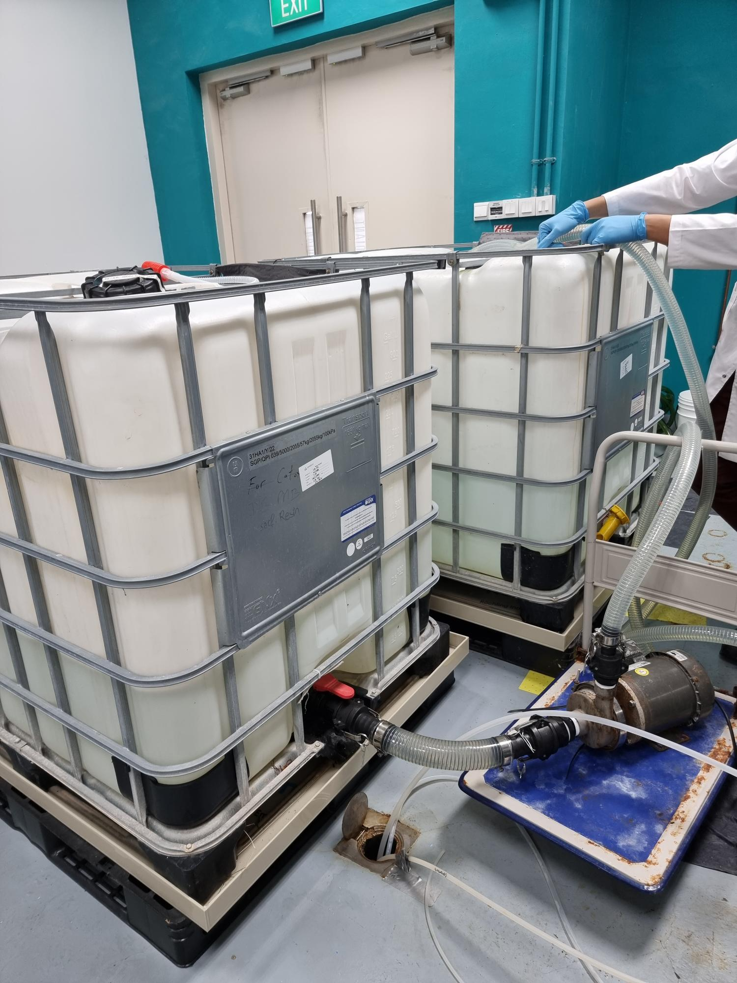
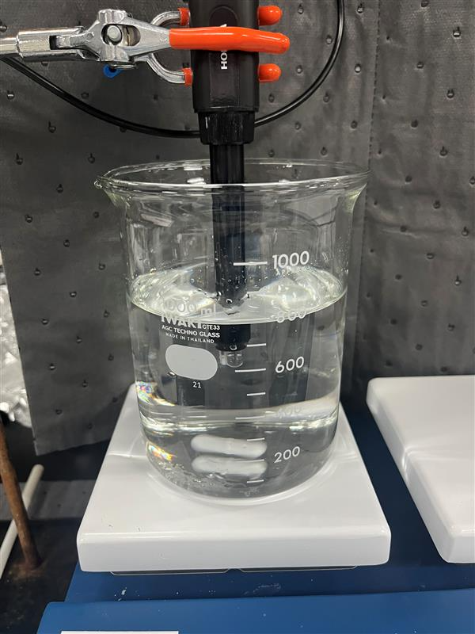
Run 1 (Short term test) Experimental Procedure
Mixing ratio LSR A2: HFW A1+A2: Chem Room = 1:1:0.03 (600 L: 600L: 16L) found out from bench test
Fluoride = 307 mg/L in the mixture
To achieve the required amount of feed fluoride (F = 350 mg/L), 114 g NaF was added to make the feed solution for Run 1
2 ppm Vitec 4000 was added into the feed tank
SBRO experiment started with 15 mins service duration + 110 sec flushing duration
4

Slide 5
Experimental conditions
Feed water volume = 1216 L
Feed water fluoride = 366 mg/L
Feed flowrate = 7.7 LPM (0.46 m3/hr)
Permeate flowrate = 6 LPM (0.36 m3/hr)
SBRO service duration = 15 mins, flushing duration 110 sec
Recovery = 78%

Slide 6
Run 1 Feed water analysis
Sample | Feed solution
pH | 7.34
Conductivity (µS/cm) | 2310
Bicarbonate alkalinity | 28.0
Fluoride (mg/L) | 366
Chloride (mg/L) | 34.2
Phosphate (mg/L) | 10.7
Sulfate (mg/L) | 6.8
Nitrate (mg/L) | 153
Ammonium as NH4 (mg/L) | 17.5
Aluminium (mg/L) | 0.13
Boron (mg/L) | 2.85
Calcium (mg/L) | 0.47
Magnesium (mg/L) | <0.1
Iron as Fe (mg/L) | 0.126
Potassium (mg/L) | 5.178
Total Silica (mg/L) | 13.3
Sodium (mg/L) | 503
TOC (mg/L) | 18.5
TDS (mg/L) | 1136

Slide 7
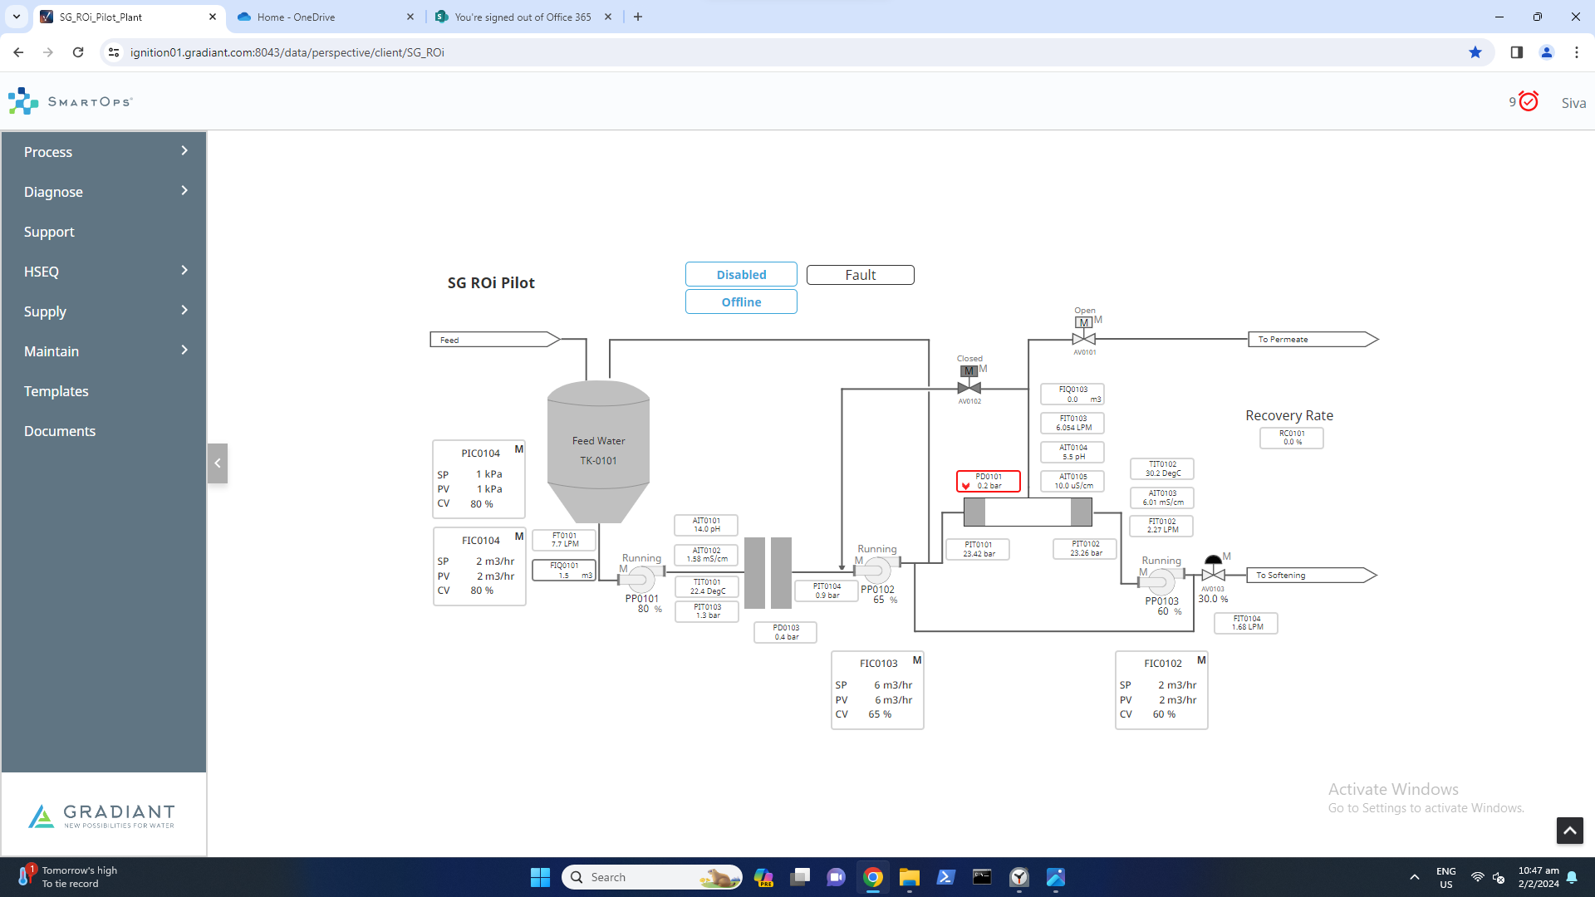

Slide 8
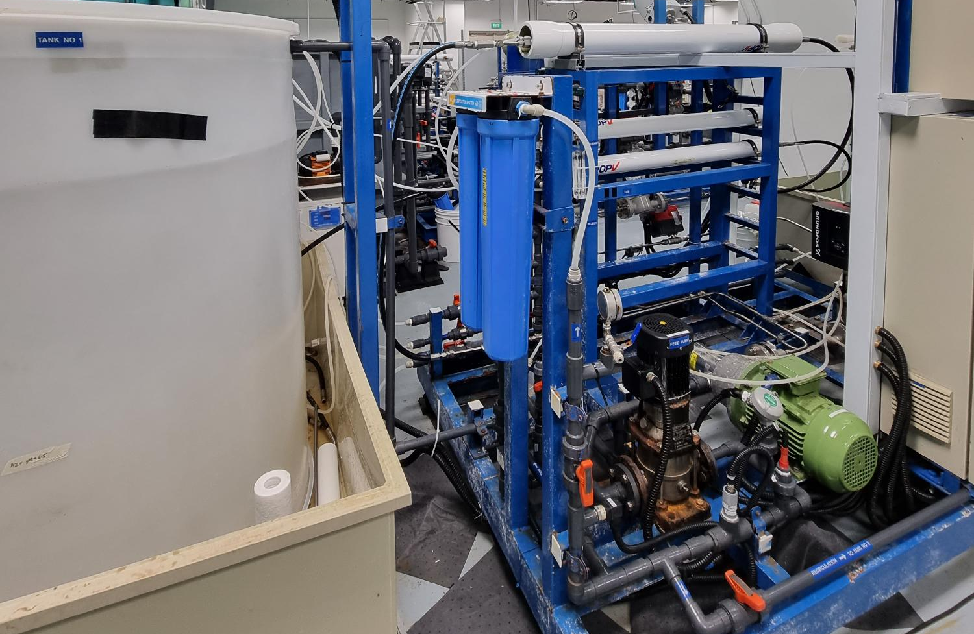
BW30 PRO-4040
Cartridge filter
Feed tank
Booster pump
High pressure pump
Notes:
Taking video for the setup, membrane autopsy after the end of the run?

Slide 9
Run 1 - SBRO Reject Conductivity Profile

Slide 10
Run 1 Permeate analysis
Sample | Results
pH | 6.46
Conductivity (µS/cm) | 82.4
Bicarbonate alkalinity | 0.8
Fluoride (mg/L) | 8
Chloride (mg/L) | 12.1
Phosphate (mg/L) | <1
Sulfate (mg/L) | 1.4
Nitrate (mg/L) | 15.9
Ammonium as NH4 (mg/L) | 3.3
Aluminium (mg/L) | <0.1
Boron (mg/L) | 0.53
Calcium (mg/L) | <0.1
Magnesium (mg/L) | <0.1
Iron (mg/L) | <0.1
Potassium (mg/L) | 0.422
Total Silica (mg/L) | <0.2
Sodium (mg/L) | 11.5
TOC (mg/L) | 3.1
TDS (mg/L) | 44

Slide 11
Run 1 Reject analysis
Sample | Results
pH | 7.26
Conductivity (µS/cm) | 7380
Bicarbonate alkalinity | 129.6
Fluoride (mg/L) | 1307
Chloride (mg/L) | 64
Phosphate (mg/L) | 38
Sulfate (mg/L) | 21.3
Nitrate (mg/L) | 507
Ammonium as NH4 (mg/L) | 0.5
Aluminium (mg/L) | 0.22
Boron (mg/L) | 10.23
Calcium (mg/L) | 1.43
Magnesium (mg/L) | 0.175
Iron (mg/L) | 0.383
Potassium (mg/L) | 6.369
Total Silica (mg/L) | 52.0
Sodium (mg/L) | 1631
TOC (mg/L) | 57.0
TDS (mg/L) | 3976

Slide 12
Summary
Initial F = 366 mg/L (>350 mg/L)
Recovery = 78% (>75%)
Effluent F = 8 mg/L (<10 mg/L)

Slide 13
Schedule
Event | Description | Date
01 | Pilot Readiness | 25-Jan
02 | Sample Collection at Site | 18-Jan to 25-Jan 23 Jan – 2 Feb
03 | Micron/Exyte witness | 01-Feb – Exyte visit
04 | Pilot Operation | 02-Feb to 23-Feb
05 | Report Preparation | 09-Feb to 22-Feb
06 | Draft Submission Review | 23-Feb to 07-Mar
07 | Final Report Submission | 08-Mar to 15-Mar

Slide 14


